Slide 1

Enterprise Blueprint
AML, KYC & Financial Crime Compliance
Institutional architecture, real-world case simulations, and advanced risk scoring frameworks.

Slide 2
Executive Summary & Compliance Core
Mitigating multi-layered financial crime risks through standardized regulatory controls and automated controls.

Slide 3
Regulatory Framework & Architecture
Risk-Based Approach (RBA)
Customer Lifecycle Controls
Establishing tiered customer segmentation (Low, Medium, High risk) based on jurisdiction exposure, product type, and transactional behavior to optimize compliance resource allocation.
Enforcing rigorous CDD for standard onboarding and mandatory Enhanced Due Diligence (EDD) paired with UBO verification for Politically Exposed Persons (PEPs) and complex legal entities.

Slide 4



Core Compliance Pillars
Identity Verification
Transaction Monitoring
Case Investigation
Automated screening against global watchlists, OFAC lists, and PEP databases using fuzzy logic thresholds.
Real-time rule engines detecting velocity anomalies, structuring behaviors, and high-risk corridor transfers.
Streamlined alert triage, false-positive tuning workflows, and SAR (Suspicial Activity Report) generation.

Slide 5
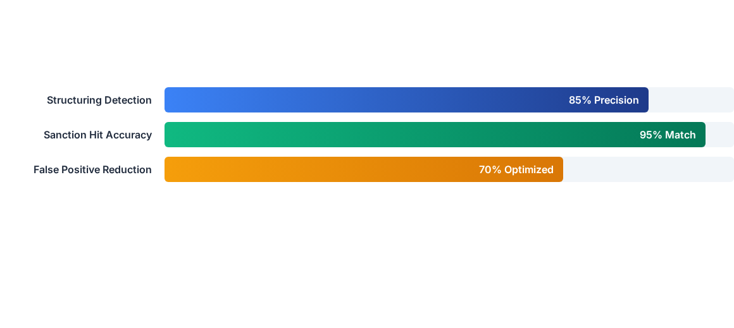
Risk Scoring Engine Metrics
Performance metrics demonstrate high detection accuracy while successfully minimizing operational overhead through automated false-positive reduction algorithms.

Slide 6
Real-World Case Typologies
Case Scenario | Typology Description | Mitigation Control
Shell Company | Multi-layered offshore structures hiding Ultimate Beneficial Owners (UBO). | Mandatory registry cross-check & UBO ownership threshold mapping.
Smurfing / Structuring | Splitting cash deposits just below the $10,000 regulatory threshold. | Velocity aggregation rules & cumulative daily threshold alerts.
Sanctions Evasion | Using alternative phonetic spellings or intermediary conduits. | Fuzzy logic name matching & secondary identifier verification.

Slide 7
Compliance Excellence
Protecting global financial systems through rigorous risk intelligence and proactive threat mitigation.
GitHub Repository: aml-kyc-fincrime-compliance-blueprint | Architecture Version v0.1.0

